Slide 1
The purpose of this slide presentation
This slide presentation is for Westcon-Comstor AWS resellers to tailor and customise for their conversations with end customers. The deck highlights the value that Westcon-Comstor enables resellers to deliver in terms of an optimised AWS environment, solutions and reduced costs.
Notes:
optimise

Slide 2
Leverage Cloud on Your Terms
ADD RESELLER LOGO HERE

Slide 3
Key questions to consider
Do you want to:
Reduce development costs?
Benefit from a robust ecosystem of applications and services?
Gain flexibility and control over your IT environment?
Access new markets and/or deliver new applications quickly?
Ensure that your IT environment supports your business priorities?

Slide 4
Why transition to cloud?
Move from capital expense to variable expense
Lower variable expenses
Stop guessing at capacity needs
Increase agility
Have time to focus on
business priorities
Expand into new markets in minutes
Notes:
Suggested notes for this slide:
Capital Expense to variable expense –
Lower variable expense – economies of scale
Stop Guessing capacity -
Increased agility – have a server set-up in minutes, not hours or days. Can build what require without constraints. Vast infrastructure technology platform
Technology people can focus on what the business needs & how it can differentiate itself, not deal with complex infrastructure. Change the shape of the business & that’s what people are excited about.
Start-ups build business from scratch in the Cloud
Speed is not just for Start-ups, companies of all sizes need to move faster than ever before

Slide 5
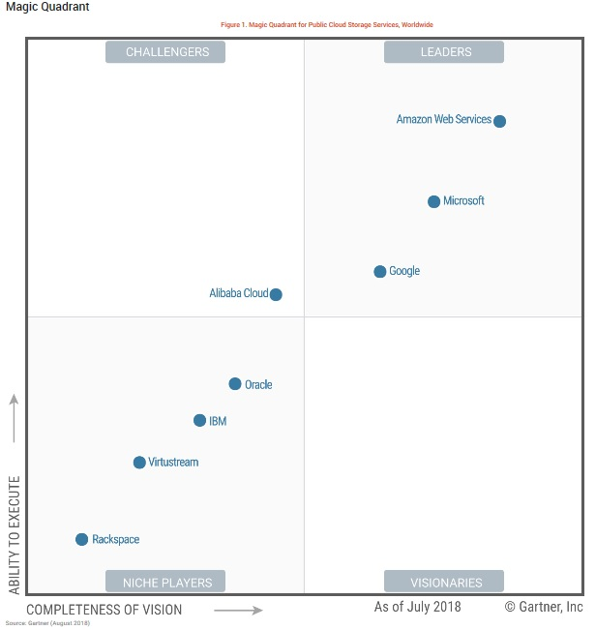
Amazon Web Services – the leading cloud platform
In the 2018 Magic Quadrant for Cloud Infrastructure as a Service, Worldwide, for the 8th straight year, Gartner placed Amazon Web Services in the “Leaders” quadrant and named AWS as having both the furthest completeness of vision and the highest ability to execute.
Broadest and deepest platform
1/3 of all internet users visit an AWS cloud- powered website daily
190 countries/13 regions

Slide 6
Realise the promise of cloud – day 1
Battle-tested methodology for deploying AWS environments
Expert AWS architecture and deployment resources
Cost-effective, high-quality solutions from infrastructure to applications
Insight and visibility into cost and resource usage for business planning
Simple local currency invoicing across multiple services
Top-notch customer support and a commitment to meeting customers’ needs
<Reseller to customise with their own bullets>

Slide 7
We deliver solutions to solve real business problems
<Reseller to add their own use case>
Source: Amazon Web Services

Slide 8
<Reseller to add their own customer case study>

Slide 9
For more information please contact:

