Slide 1

BlueSky Overview
BlueSky Overview
Date

Slide 2


CONTENT
Our Cloud Promises
A solution-first approach
Value of BlueSky
Roadmap
Demo
Regional implementations

Slide 3



Westcon-Comstor linking today’s supply chain
Reduce complexity, increase efficiency
OEMs/Vendors
End
Customer
End
User
MSPs & Telcos
Iaas
PaaS
SIs
SaaS
MSPs
& Telcos
VARs

Slide 4





Our Five Cloud Promises
Developed to enable your cloud business success
We provide global reach and scale with local expertise to help you enter and serve new markets
We systematically identify, qualify
and onboard new vendors for the
most comprehensive cloud
solutions portfolio
We enable you to thrive
in the digital services market
We keep you at the center of
the digital services life cycle, ensuring
you profit from every transaction
We offer hybrid solutions
to help you meet your customers’ needs

Slide 5

Global cloud expertise and reach
19 countries and 5 languages
APIaaS for all vendors
Global 24X7 support
43%
5 year CAGR forecasts of our cloud business
1,400+
Resellers transacting cloud
38/43+
Unique vendors/
Cloud services
300+
Collective years
of cloud experience

Slide 6
BlueSky Global Country Availability
Geo Coverage as of March 2017
EMEA
South Africa
Namibia
Malawi
Botswana
Zambia
Zimbabwe
Ghana
Kenya
Mauritius
Mozambique
Tanzania
Germany*
Middle East*
Nordics*
NA
US
Canada
APAC
New Zealand
Australia
Singapore
Indonesia
China*
LATAM
Brazil
Colombia
Mexico
Argentina*
Confidential
* New Launches 2017

Slide 7












A solution-first approach
SOLUTIONS
UNIFIED COMMUNICATIONS
Telephony
Video
Conferencing
Hosted Wireless
UCC Suite
Focus on strong market growth areas that align with core competencies
Serve unique customer needs in enterprise, mid-market and SMB
Complement our IaaS partnerships
Accelerate sales motion and results
SECURITY
SIEM &
Security Analytics
Cloud Access
Secure Brokers
PROFESSIONAL & MANAGED SERVICES
PROFESSIONAL & MANAGED SERVICES
Secure Web
Gateway
Cloud Endpoint
Identity &
Access Mgmt
Cloud USM
INFRASTRUCTURE as a SERVICE (IaaS)
Notes:
Cloud security market should reach $8B by 2019 and UCC should reach $4.5B by 2021 – Markets and Markets. UCC - Gartner reports larger numbers for UCC cloud (over 15B by 2019)
Gartner reports from 2016, list the IaaS market size to be $22B. Amazon holds 35% of the market share, Microsoft 15%, IBM 10%, Google 5% and the remaining 35% is split amongst Alibaba, Century Link and other Next Gen IaaS providers.

Slide 8


















World-class partners create
the foundation for solutions
+
Recruit and incubate industry leaders and innovators
Provide flexibility for regions
to support unique needs
Engage with partners and
build competitive edge
Leverage our core expertise
Execute at the edge; scale at the core
Structure win-win relationships
EXAMPLES OF OUR CLOUD PARTNERS

Slide 9

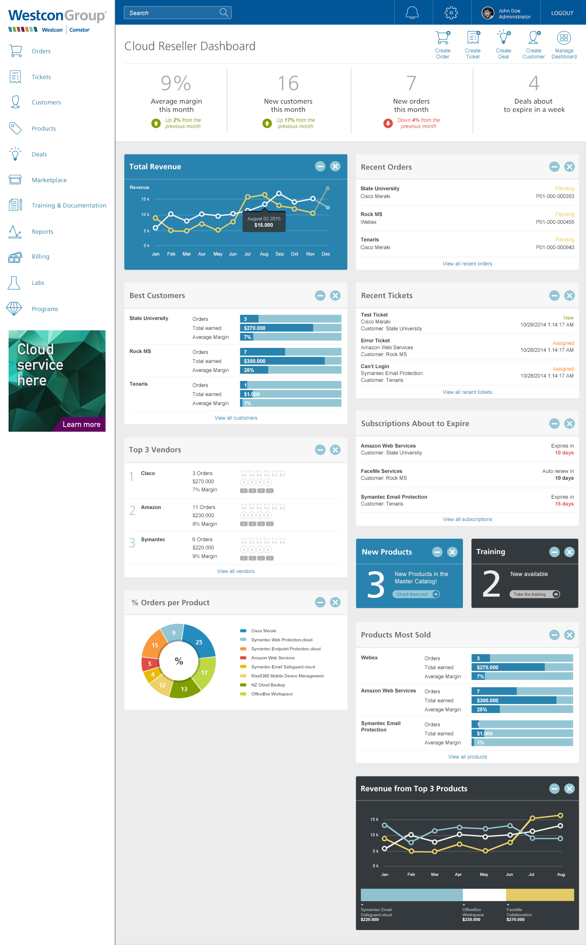
BlueSky: Cloud and service management platform drives value for our partners
For vendors a more effective
way to reach resellers
Efficient service delivery and management for resellers
Partner
Reporting
Service
Performance
Monitoring
Product
Knowledgebase
BlueSky
Service
Governance
Marketing and communications
Visibility and insight
Tighter partnerships
Integrated solution opportunities
Faster time to market
Visibility and insight
Cost control
Business agility
Streamline business
operations
Better customer service
Branded cloud services
Usage
Analytics
Hybrid Cloud
Management
Hybrid
Marketplace
Consumption-based
Billing and Metering
Cloud Service Provider
Application
Lifecycle
Security
Policy
License
Management
Storage
Cloud
Accounts

Slide 10





BlueSky: We are investing in your success
We keep you at the center of the digital services
life cycle, ensuring you profit from every transaction
TOOLS
Close more opportunities with our BlueSky Cloud and Service Management platform, CapEx to OpEx financing models, sales tools, marketing campaigns … and more
ANALYTICS
Monitor customer usage; manage profit margins by tracking product use, renewals and service contracts
Gain insight to cross-sell and up-sell opportunities
SINGLE SIGN-ON DIGITAL LOGISTICS SERVICE
Enable your customers to review, order, track and analyze hardware, software, education and service products
BACK OFFICE OPERATIONS
Alleviate operational burdens and costs with order capture, order fulfillment and “billing on your behalf”

Slide 11

Universal BlueSky Features
High level view of product usage, top customers, revenue, profit and additional areas
Dashboard
Receive actionable
recommendations across multiple “as a Service (XaaS)” deployments to improve efficiency, cut costs, enhance performance
In-Depth
Optimization
Upload customer database
and maintain customer details
Customers
View customer orders and processing and invoicing files
Monitor pipeline with service subscription expiration dates, proactively plan for recurring revenue
Billing
Subscriptions
Orders
Enhanced visibility to cloud service data including
customer usage for each service and last-minute status of orders
Notes:
Keeping You at the Center
Dashboard
Acquire a better understanding of how to optimize your cloud business with a high level
view of product usage, top customers, revenue, profit and additional areas
Customers
Upload your customer database, maintain customer details.
Subscriptions
Monitor your pipeline with service subscription expiration dates to proactively
develop and plan your business.
Orders
Boost your visibility to critical cloud service data, including customer usage for each
service and the last-minute status of your orders.
Billing
View customer orders and processing, including invoicing files to manage monthly revenue and maintain customer relationships.
In-Depth Optimization
Receive actionable recommendations across multiple Infrastructure as a Service (IaaS) deployments to improve efficiency, cut costs and enhance performance.

Slide 12

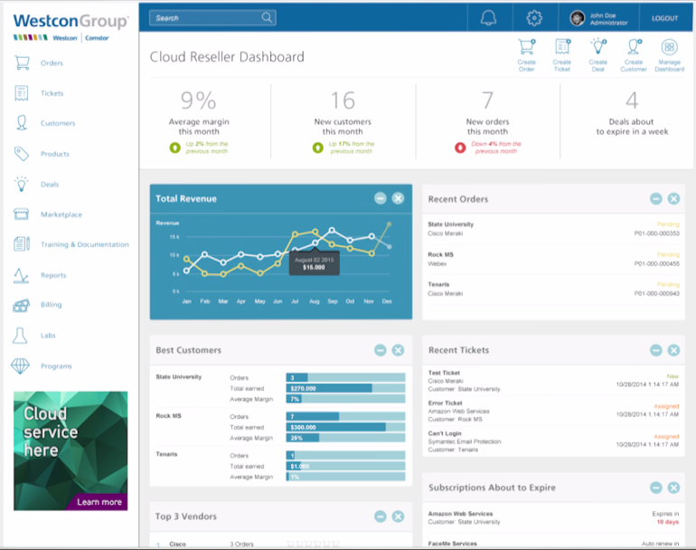
Value Add: Visibility into customer details
Understand lifecycle: purchase, renewal, disconnects, churn, up-sell, cross-sell
CUSTOMER
OPTPIMIZATION

Slide 13
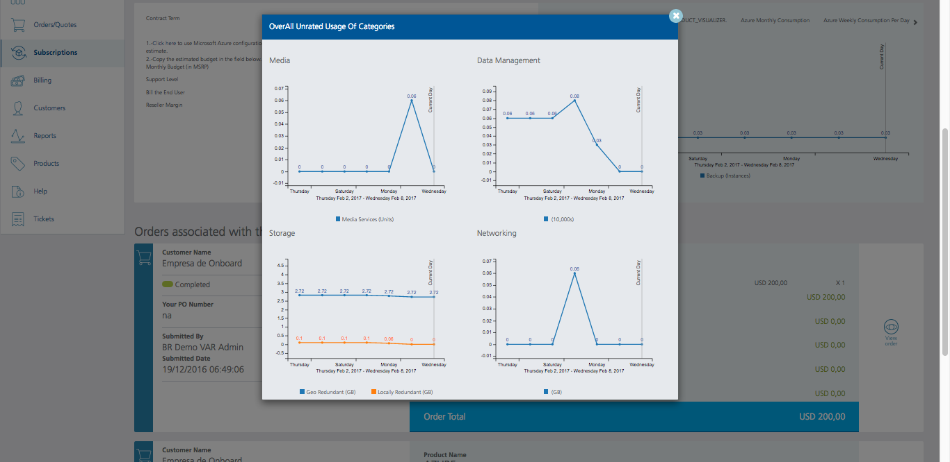
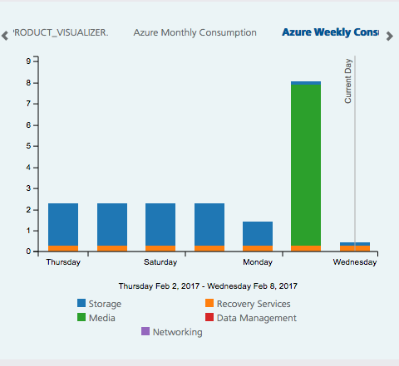
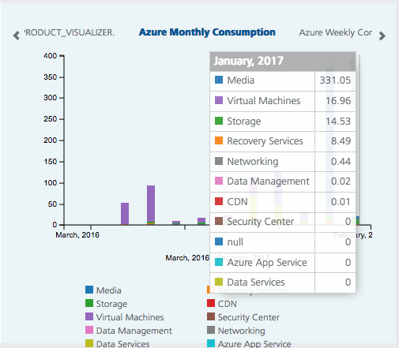
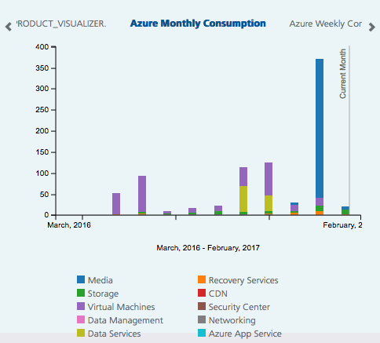
Value Add: Utilization analytics
Understand customer usage trends
DASHBOARD

Slide 14
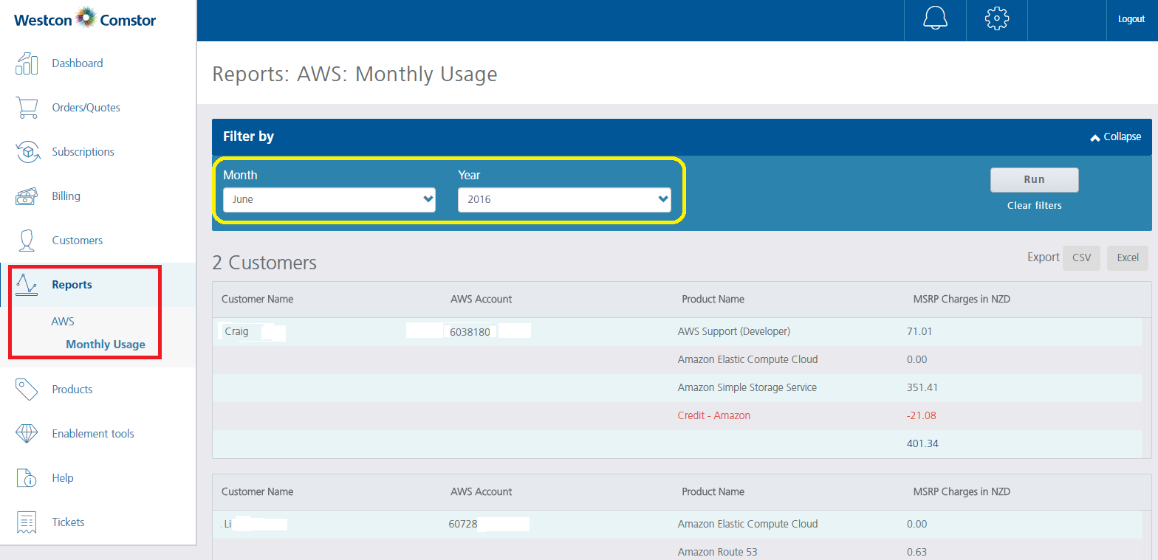
Value Add: Streamlined billing
A simple click to your monthly billing report in BlueSky
BILLING

Slide 15
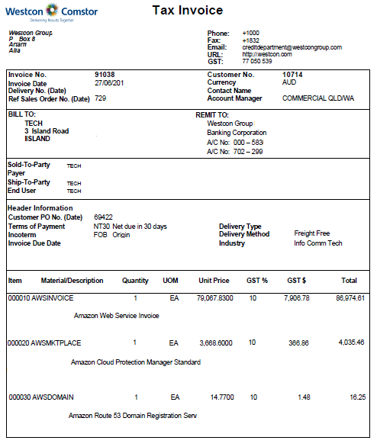
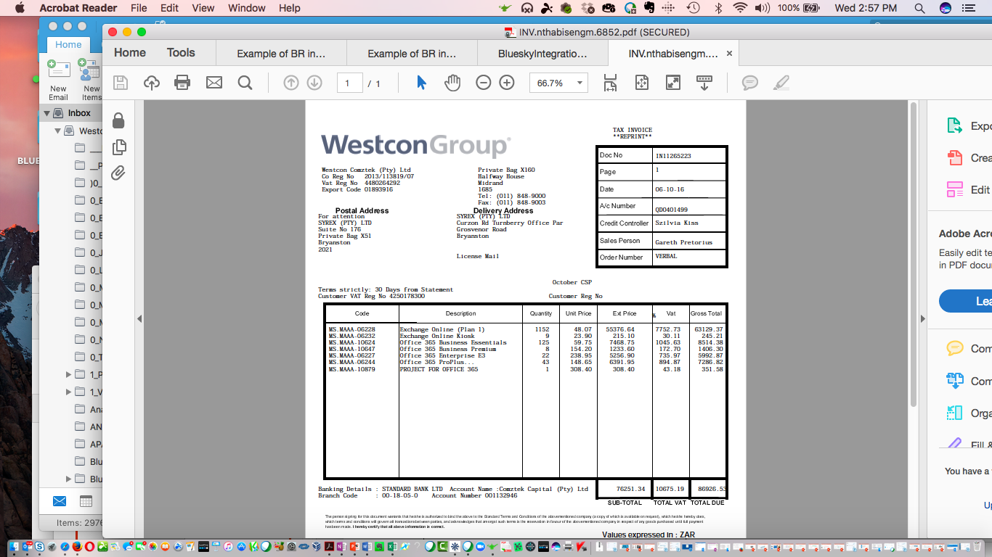
Value Add: Simplified invoicing
Consolidation of orders bolsters back office operations
BILLING

Slide 16
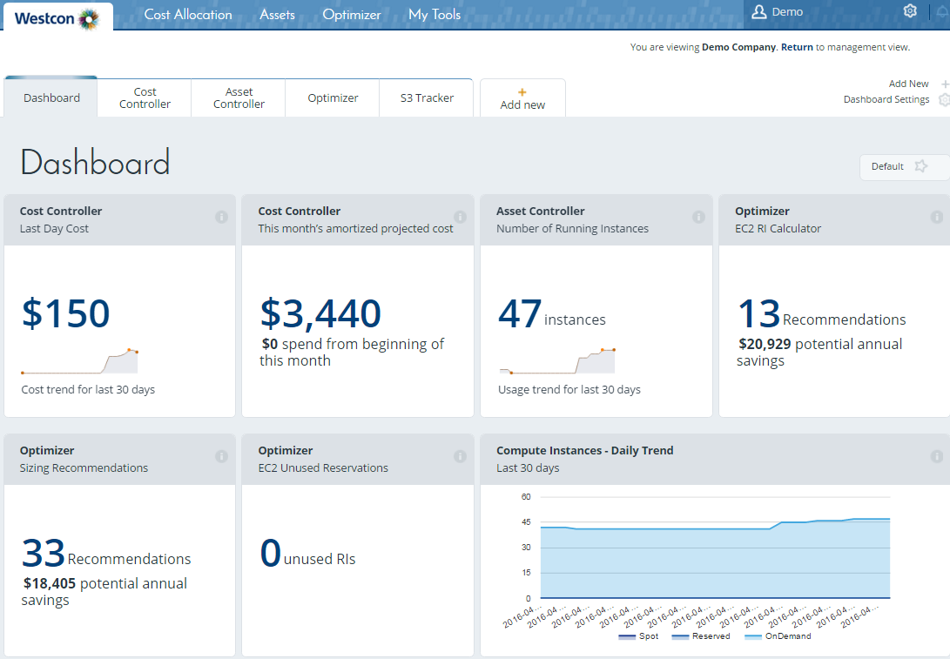
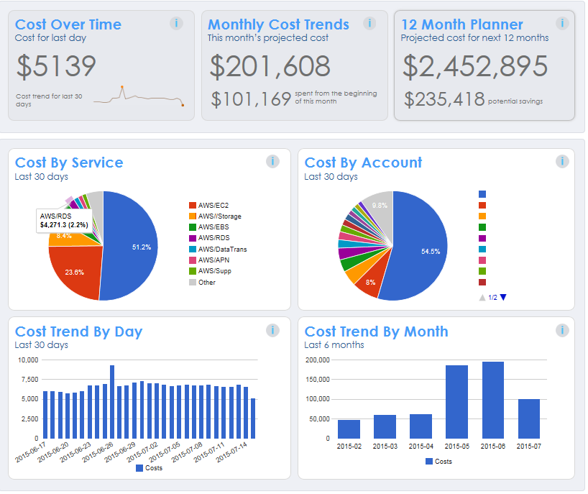
Value Adds: Visibility to cloud service data
Increases transparency, speeds time to revenue
ORDERS &
SUBSCRIPTIONS

Slide 17




Westcon-Comstor “Single Pane of Glass” for hybrid and digital logistics
ORDERS
OEMs • ISVs • CSPs • Resellers/Solution Providers • End Users • Employees
Single entry portal
------
------
------
------
------
Monitoring, performance, renewals and life cycle management
Analytics
and enablement
Business operations services, billing, lead generation, up sell, technical support

Slide 18
BlueSky Enhancement Plans
Keeping our partners at the center of the transaction
SERVICE
DELIVERY
USER
EXPERIENCE
DASHBOARD
CUSTOMERS
ORDERS
PURCHASING
  Enhance consumption and
  usage analytics
  Continue regional expansions
  Global 24X7 support
  White label webstore capabilities
  Enhanced visibility to cloud service data including customer usage for each service and last-minute status of orders
  Integrated hybrid purchasing
  Vendor and back office integration
  Reduce onboarding time
  Improve UI/UX features
  Multi-language/ multi currency
FAST CHANNEL ACTIVATION | IGNITE NON-TRANSACTING PARTNERS | EFFICIENT BACK-OFFICE SUPPORT
CROSS-SELL/UP-SELL | MULTI LANGUAGE AND CURRENCY | DETAILED ANALYTICS ON USAGE AND CONSUMPTION

Slide 19

BlueSky Demonstration

Slide 20




BlueSky – Asia Pacific regional features
Multi-dimensional cloud cost, performance and usage reporting
Optimized actionable recommendations
for sizing, pricing, location and vendor modifications
Business and data intelligence to control P&L and optimize cost/profit margin per customer
Governance and reporting of role
and client-based predictive usage
and budgeting
User-defined
“what if” cost and capacity simulation and projection
Notes:
Features include (from APAC)
Multi-dimensional cloud cost, performance and usage reporting
Optimized actionable recommendations for sizing, pricing, location and vendor modifications
Business and data intelligence to control P&L and optimize cost/profit margin per customer
Governance and reporting of role and client-based predictive usage and budgeting
User-defined “what if” cost and capacity simulation and projection

Slide 21
BlueSky – North American regional features
Multi-dimensional cloud cost, performance and usage reporting
Optimized actionable recommendations
for sizing, pricing, location and vendor modifications
Business and data intelligence to control P&L and optimize cost/profit margin per customer
Governance and reporting of role
and client-based predictive usage
and budgeting
User-defined
“what if” cost and capacity simulation and projection

Slide 22
BlueSky – Latin America regional features
Multi-dimensional cloud cost, performance and usage reporting
Enable partners to directly manage cloud customers’ lifecycle through the ability to provision, order and manage subscriptions
Business and data intelligence to control P&L and optimize cost/profit margin per customer
Opportunities to sell integrated offers and services by attaching
professional services, managed services and support to every subscription
Reseller dashboard and analytics – real-time analytics capabilities and event notifications provide insight into service usage and trends that help Westcon-Comstor customers make better, more informed business decisions.

Slide 23
BlueSky – Middle East and Africa regional features
Multi-dimensional cloud cost, performance and usage reporting
Enable partners to directly manage cloud customers’ lifecycle through the ability to provision, order and manage subscriptions
Business and data intelligence to control P&L and optimize cost/profit margin per customer
Opportunities to sell integrated offers and services by attaching
professional services, managed services and support to every subscription
Reseller dashboard and analytics – real-time analytics capabilities and event notifications provide insight into service usage and trends that help Westcon-Comstor customers make better, more informed business decisions.

