Slide 1
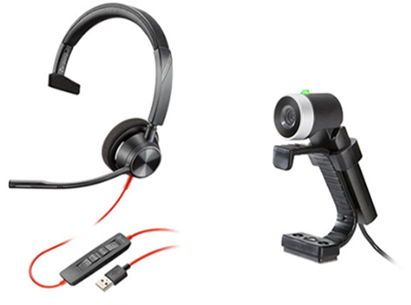
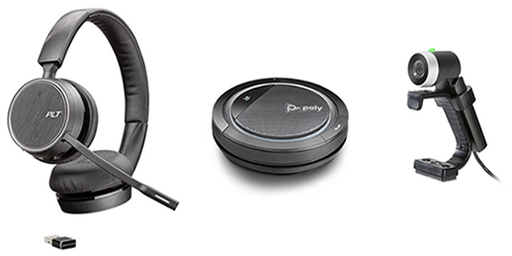
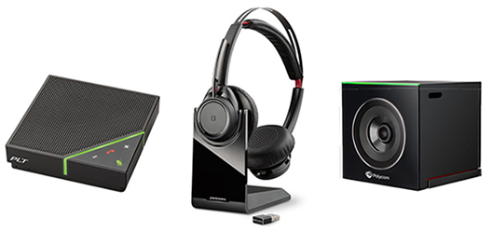
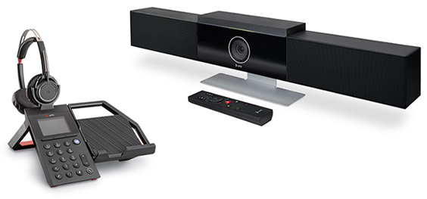
PLACE YOUR LOGO
Working from home
There is an increased desire to work from home. But are you correctly equipped and ready for the pitfalls? We can help you with the right solution for your remote working needs – from simple set up to executive home office.
Latest software
Audio solutions
Using video
Finishing touches
Ensure you always have the latest collaboration software on your devices.
Finding the right audio solution is key, so you have the best sound despite any background noise.
Using video conferencing is key for you to collaborate with colleagues or external partners.
It's not just the audio and video. Don't forget a comfortable chair and good lighting.
Remote working bundles
Simple
set-up
Versatile
home
office
Blackwire 3310 headset and EagleEye Mini camera instantly add business-quality audio and video collaboration.
Voyager 4220 UC headset, Calisto speakerphone and EagleEye Mini camera offers the ease of multiple connection options.
All-day
video
conferencing
Executive
home
office
Voyager Focus noise-cancelling headset, Calisto 7200 speakerphone and EagleEye Cube camera allow the user to listen comfortably and move about during meetings.
Elara 60 series smartphone station and Studio USB video bar (Certified for Microsoft Teams) provide the most versatility and performance of all the Poly bundle options.
Now is the time to work remotely. Contact us for more information about the bundles or how to get started.
CONTACT DETAILS

